Slide 1
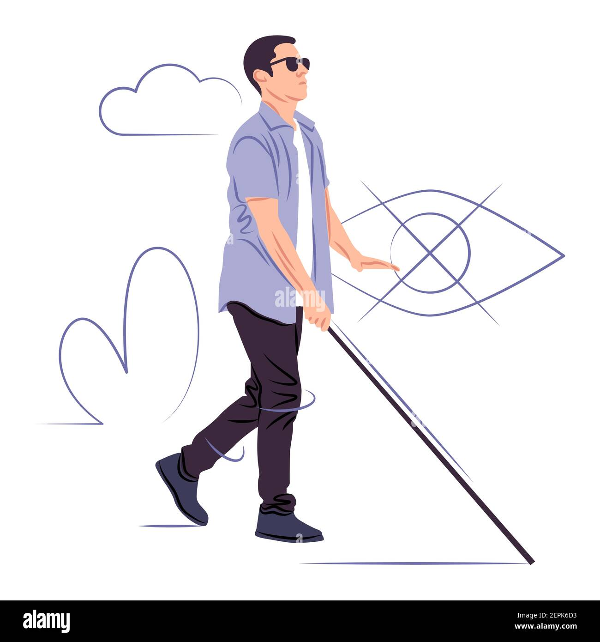
SMART BLIND STICK
Keep it smart with smart blinds.
Group Members:
Priya Kushawaha
Samira Shahi

Slide 2
TABLE OF CONTENTS
01
02
03
INTRODUCTION
OBJECTIVES
COMPONENTS
04
05
06
FUTURE SCOPE
CONCLUSION
ADVANATAGES & DISADVANTAGES

Slide 3
INTRODUCTION
“Smart Blind Stick” by using Arduino is about the project that helps blind community to get better access to the environment. The design is incorporated with Ultrasonic sensor for Obstacle detection and a buzzer to alert the blind. Ultrasonic sensors are used to calculate the distance of the obstacle around the blind person.

Slide 4
OBJECTIVES
Assist with mobility and navigation for people with visual impairments.
Increase safety and independence for users.
Provide real-time obstacle detection and alerts.
Reduce the risk of accidents or falls.
Allow for customizable feedback based on user preferences.
Improve overall quality of life for people with visual impairments.

Slide 5
COMPONENTS USED IN SMART BLIND STICK
ARDUINO UNO
HC-SR04 ULTRASONIC SENSOR
BUZZER
LED
JUMPER WIRE
9V BATTERY

Slide 6
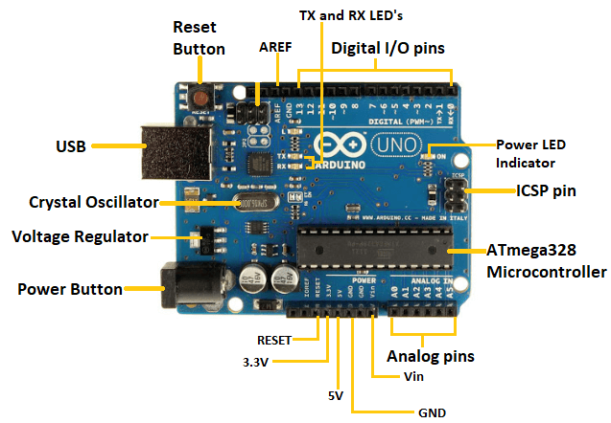
ARDUINO UNO

Slide 7
ARDUINO UNO
The Arduino Uno is a microcontroller board based on the ATmega328P chip.
It has 14 digital input/output pins and 6 analog inputs.
It can be programmed using the Arduino IDE, which is based on Processing.
It is easy to use, low cost, and versatile.
It is popular for hobbyist and professional projects such as robotics and home automation.

Slide 8
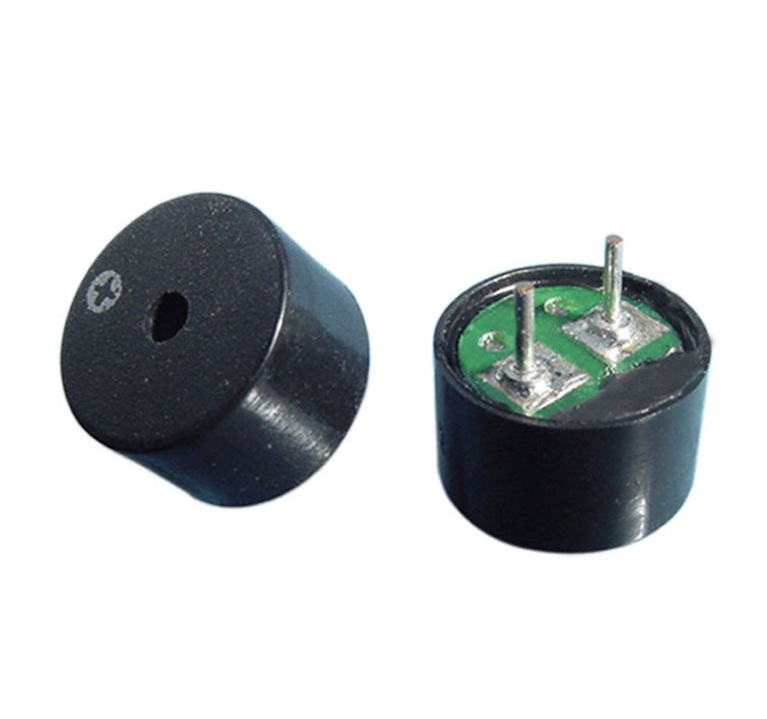
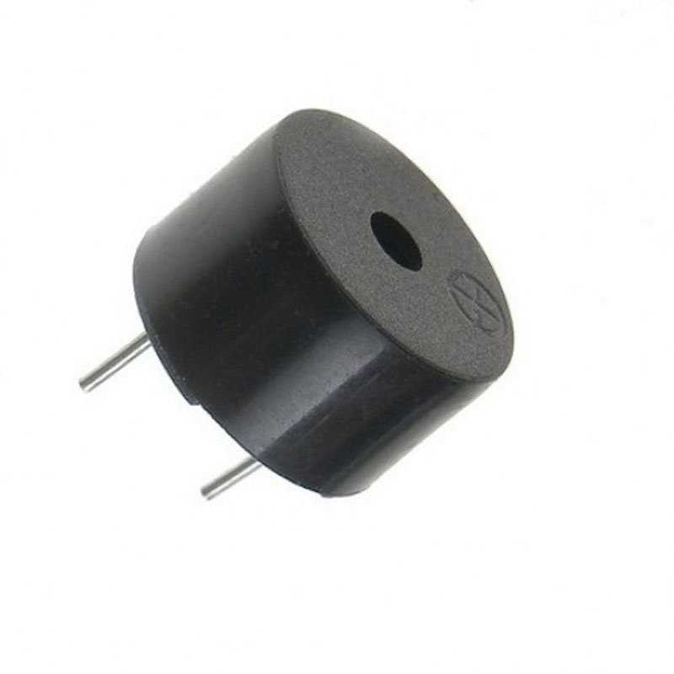
PIEZO BUZZER

Slide 9
PIEZO BUZZER
Piezo buzzers produce sound using a crystal.
They are commonly used in Arduino projects and controlled by code.
Different sounds can be generated by changing the frequency and duration of the digital signal.

Slide 10
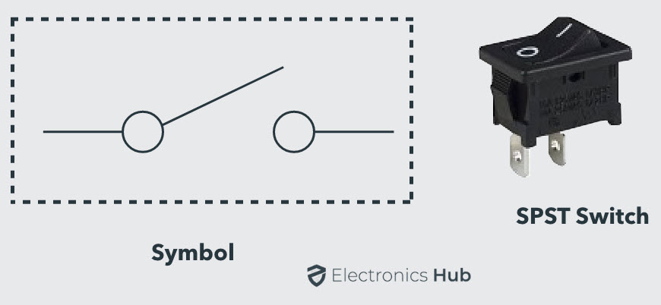
SWITCH

Slide 11
SWITCH
It is a type of switch that has a single input and a single output, and can be either on or off.
SPST switches are commonly used in electronic circuits for simple on/off operations.

Slide 12
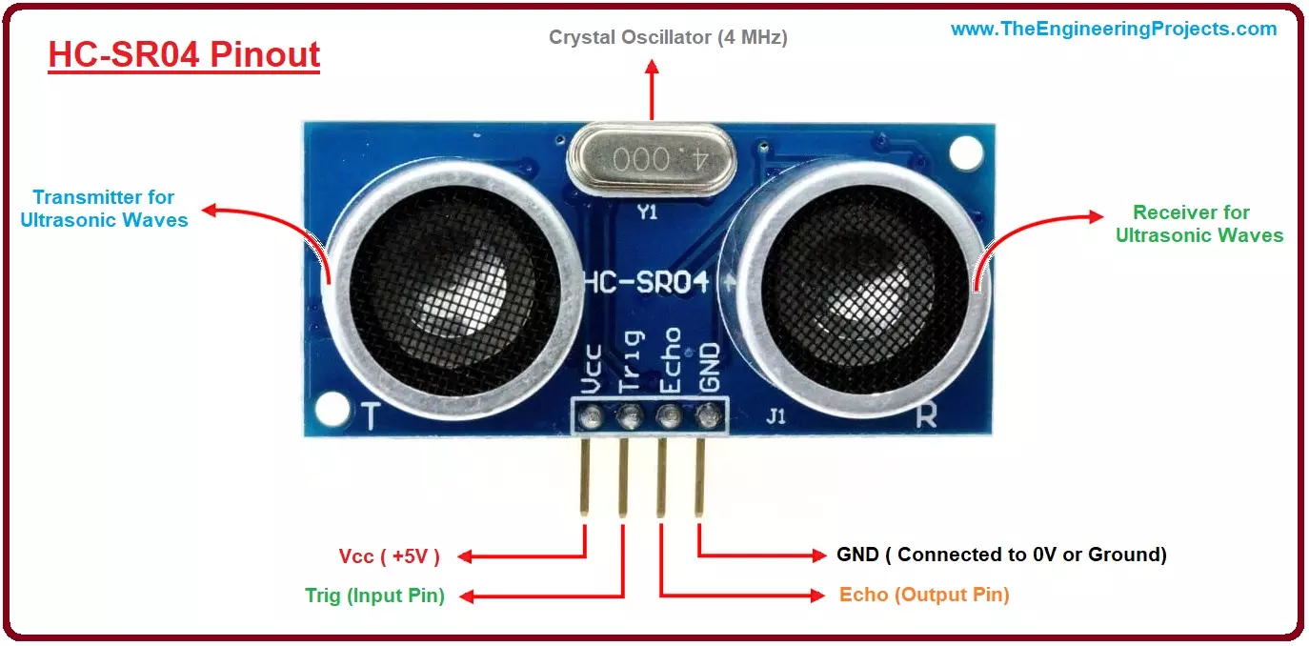
ULTRASONIC SENSOR

Slide 13
ULTRASONIC SENSOR
HC-SR04 Ultrasonic Sensor measures distance using sound waves.
It has a range of 2cm to 400cm and high accuracy.
It works by sending ultrasonic waves and measuring the time they take to bounce back.
It is commonly used in robotics, drones, and automation due to its low cost and ease of use.

Slide 14
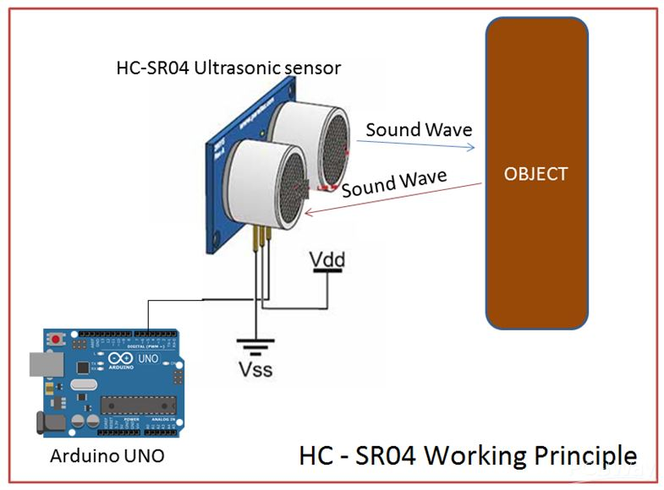
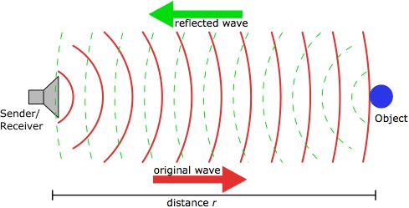
WORKING PRINCIPLE

Slide 15
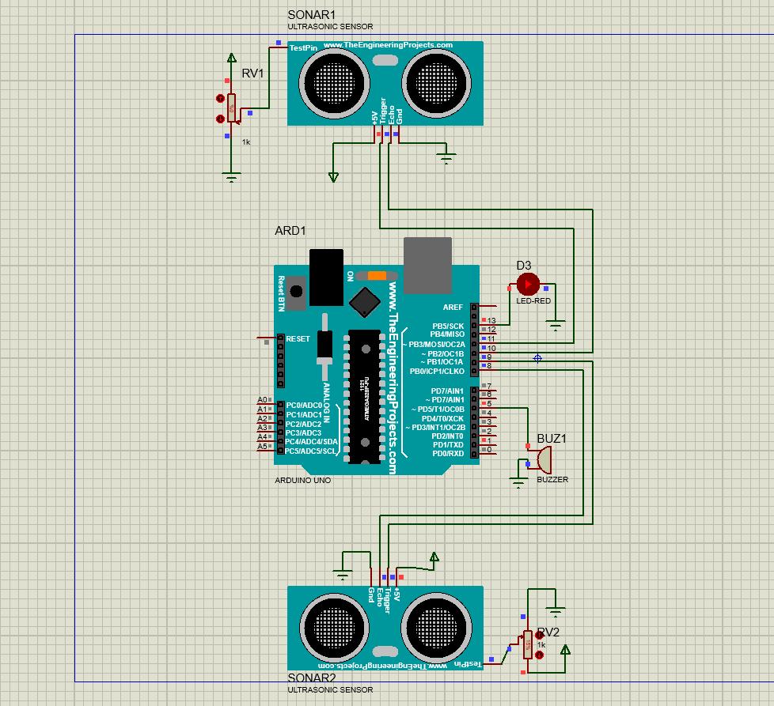
PROTEUS SIMULATION

Slide 16
Advantages
Auto Detection
Simple to use and low cost
Fully paperless system
Disadvantages
Limited and fixed route to follow
Little sensor support

Slide 17
FUTURE SCOPE
Add GPS technology for better navigation and guidance
Adding infrared or LIDAR sensors for greater accuracy in detecting obstacles
Designing the smart blind stick to be more aesthetically appealing and customizable
Integrating a rechargeable battery to increase convenience for the user

Slide 18
CONCLUSION
Overall, the Smart Electronic Guiding Stick has the potential to greatly improve the quality of life for blind people, providing them with a safer and more independent means of navigation.
The project demonstrates the power of technology in addressing real-world problems and creating positive social impact
Technology can drive innovation for social impact.
System can be customized to meet different user needs.

Slide 19
THANK YOU!!!

